Slide 1
ENM 31013
Linguistics & Syntax
Lecturer: Safna Anwer
BA (Hons.) English (Special)- USJ
Instructor at UVPA
Visiting Lecturer at SEUSL

Slide 2
Content
The origin of language
The Divine Source
The Natural Sound Source
The Physical Adaptation Source
The Genetic Source
Theories of the Origin of Language
Summary

Slide 3
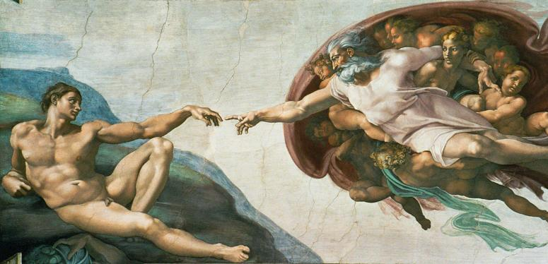

Slide 5
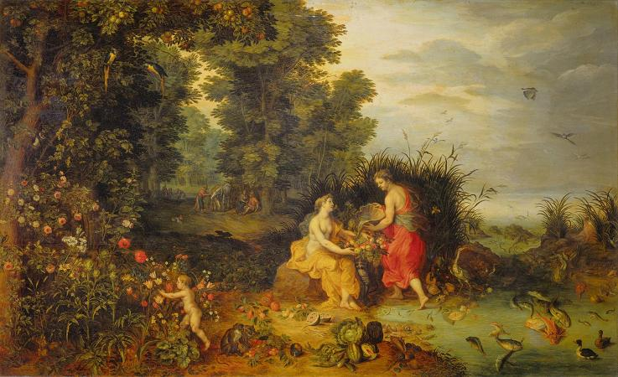

Slide 7
The Divine Source
Biblical tradition : “God created Adam and whatsoever Adam called every living creature, that was the name thereof”
Hindu tradition : Language came from Saraswathi, wife of Brahma, creator of the universe.
In most religions divine source provides humans with language.
Hypothesis: if human infants were allowed to grow up without hearing any language around them, then they would spontaneously begin using the original God-given language
Ex: Egyptian Pharaoh named Psammetichus

Slide 9
The Natural Sound Source
The primitive words could have been imitations of the natural sounds.
When an object flew by, making a CAW-CAW sound, the early human tried to imitate the sound and used it to refer to the thing associated with the sound
In English words like:
COO-COO
Splash
Bang
Boom
Rattle
Buzz
Hiss
Screech
Bow-wow
It has also been suggested that the original sounds of language may have come from natural cries of emotion such as pain, anger and joy (Ouch!, Ah!, Ooh!, Wow!, Yuck!)

Slide 10
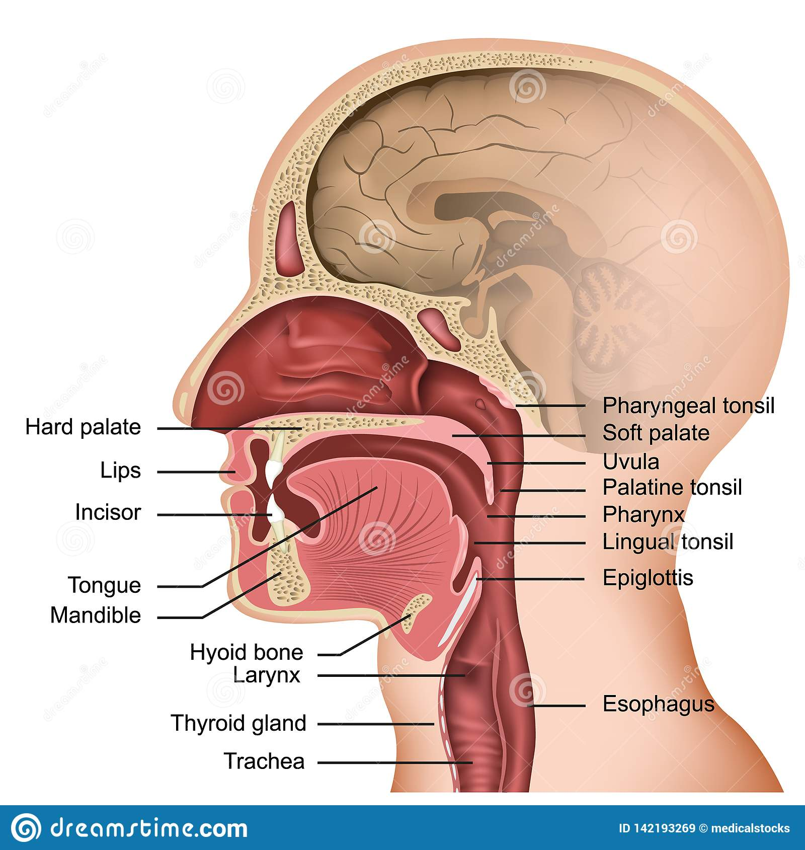

Slide 11
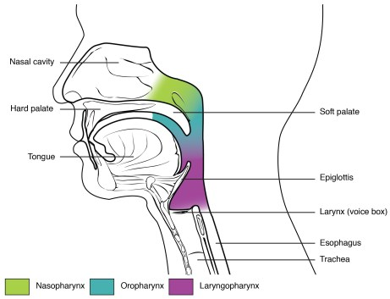
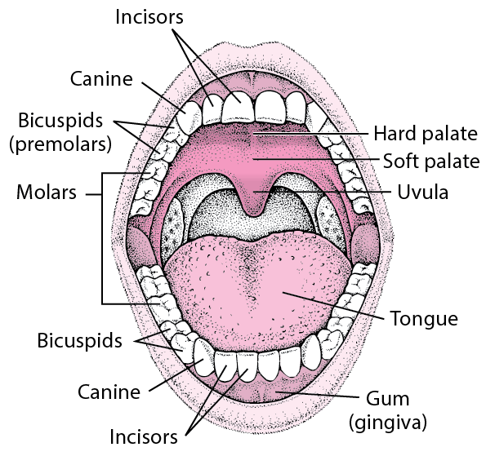

Slide 12
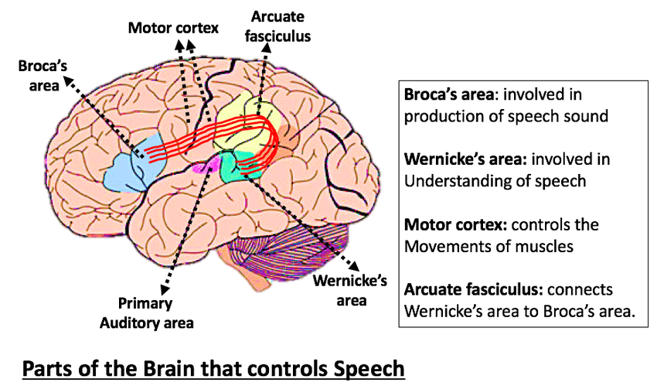

Slide 13
The Physical Adaptation Source
Here we look at the physical features of humans possess instead of looking at types of sounds as the source of human speech.
Teeth
Lips
Mouth
Larynx
Pharynx
Human brain

Slide 15
The Genetic Source
Innateness Hypothesis
Human beings are born with knowledge of the fundamental principles of grammar
Human offspings are born with a special capacity for language

Slide 16
Summary
https://issuu.com/li2015/docs/origins_of_language

Slide 17
Thank you!

