Slide 1
Lesson 01 Introduction
MIT 11053, Fundamentals of Programming
By: S. Sabraz Nawaz
Senior Lecturer in MIT
Department of MIT
FMC, SEUSL

Slide 2
Programs
Computer programs, known as software, are instructions to the computer.
You tell a computer what to do through programs. Without programs, a computer is an empty machine. Computers do not understand human languages, so you need to use computer languages to communicate with them.
Programs are written using programming languages.

Slide 3
Programming Languages
Machine Language Assembly Language High-Level Language
Machine language is a set of primitive instructions built into every computer. The instructions are in the form of binary code, so you have to enter binary codes for various instructions. Programming with native machine language is a tedious process. Moreover the programs are highly difficult to read and modify. For example, to add two numbers, you might write an instruction in binary like this:
1101101010011010

Slide 4
Programming Languages
Machine Language Assembly Language High-Level Language
Assembly languages were developed to make programming easy. Since the computer cannot understand assembly language, however, a program called assembler is used to convert assembly language programs into machine code. For example, to add two numbers, you might write an instruction in assembly code like this:
ADDF3 R1, R2, R3

Slide 5
Programming Languages
Machine Language Assembly Language High-Level Language
The high-level languages are English-like and easy to learn and program. For example, the following is a high-level language statement that computes the area of a circle with radius 5:
area = 5 * 5 * 3.1415;

Slide 6
Popular High-Level Languages
COBOL (COmmon Business Oriented Language)
FORTRAN (FORmula TRANslation)
BASIC (Beginner All-purpose Symbolic Instructional Code)
Pascal (named for Blaise Pascal)
Ada (named for Ada Lovelace)
C (whose developer designed B first)
Visual Basic (Basic-like visual language developed by Microsoft)
Delphi (Pascal-like visual language developed by Borland)
C++ (an object-oriented language, based on C)
C# (a Java-like language developed by Microsoft)
Java (We use it in this course)

Slide 7
How a Computer Program Works
The Program you write is executed by the CPU
Since the CPU can only understand machine code your program needs to be converted into machine code
C8
B7
23A7
D7
AA
89
DD
89D23
A9
F4
A9
...
Dim radius as integer
Dim area as integer
radius = txtRadius.text
area = 22/7*radius*radius
msgbox area
Source Code
Machine Code

Slide 8
How a Computer Program Works
Programmer writes the code in a high level language such as C++, Java, Visual Basic etc.
Then using a software tool this high level code is converted into machine code.
The software tools that does the conversion to machine code comes in two flavours
Compilers
Interpreters

Slide 9
Compilers and Interpreters
Compiler
A compiler converts your entire program to machine code at one go
After compilation you have an executable file in machine code
e.g. an EXE, COM file for PCs
Interpreter
An Interpreter converts your program to machine code one instruction at a time

Slide 10
Compiling Source Code
A program written in a high-level language is called a source program. Since a computer cannot understand a source program, program called a compiler is used to translate the source program into a machine language program called an object program. The object program is often then linked with other supporting library code before the object can be executed on the machine.

Slide 11
Developing Programs that run on Multiple Platforms
You need to find a language that is supported by different platforms
e.g. Visual Basic is only for PCs, C, C++ on the other hand are available for any type of computer
We say that languages like C, C++ are portable at the source level
i.e. Since these languages have standards the program you write (source code) could be compiled on different platforms with little or no modifications

Slide 12
What makes Java Special ?
Java is platform independent at the binary level
i.e. If you write a program in Java and compile it you could run your compiled code on any type of computer
When you compile a java program it does not produce machine code for a specific type of computer

Slide 13
How Java works ?
It creates machine code for a general virtual computer
This is referred to as java byte code
There are Java Interpreters available for almost all types of computer platforms
To run your Java program you need the Java Interpreter installed in that computer
It would convert the java byte code to the specific machine code of your computer

Slide 14
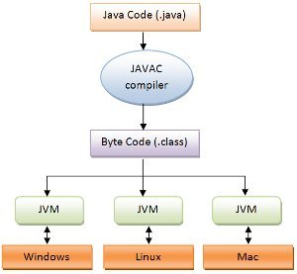
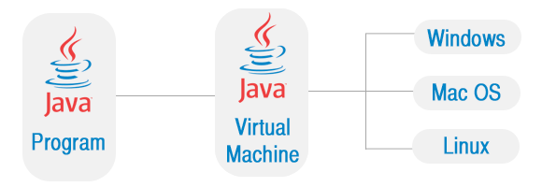
How Java works ?

Slide 15
Program Development Process
Text editor
Saves Java statements
Source code
(.java)
Is read by
Byte code (.class)
Java compiler
Produces
Is interpreted by
Program
Execution
Java
Virtual
Machine
Results in

Slide 16
A Simple Java Program

Slide 17
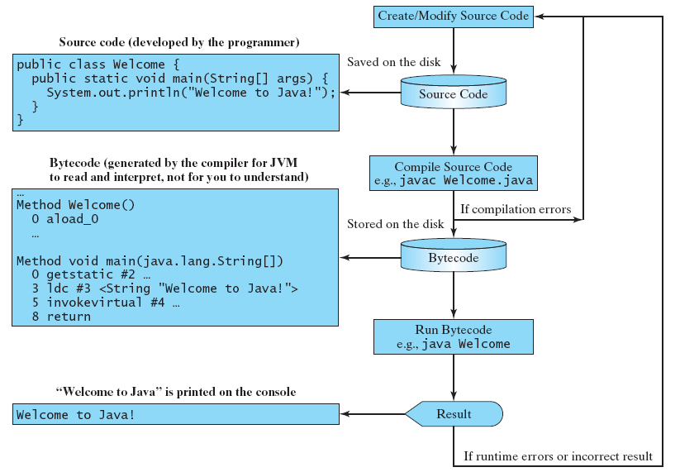
Creating, Compiling, and Executing a Java Program

Slide 18
The Compiler and the Java Virtual Machine
Most compilers translate source code into executable files containing machine code
The Java compiler translates a Java source file into a file that contains byte code instructions
Byte code instructions are the machine language of the Java Virtual Machine (JVM) and cannot be directly executed directly by the CPU

Slide 19
The Compiler and the Java Virtual Machine
Byte code files end with the .class file extension
The JVM is a program that emulates a micro-processor
The JVM executes instructions as they are read
JVM is often called an interpreter
Java is often referred to as an interpreted language.

Slide 20
Java Virtual Machine
The Java Interpreter is more popularly known as the Java Virtual Machine (JVM). It is also known as the Java Runtime
This is available with the operating system of most computers today

Slide 21
Java Virtual Machine
(a) Java source code is translated into bytecode.
(b) Java bytecode can be executed on any computer with a Java Virtual Machine.

Slide 22
Try these out…
Ex 01
Ex 02

Slide 23
End of Lecture

