Slide 1
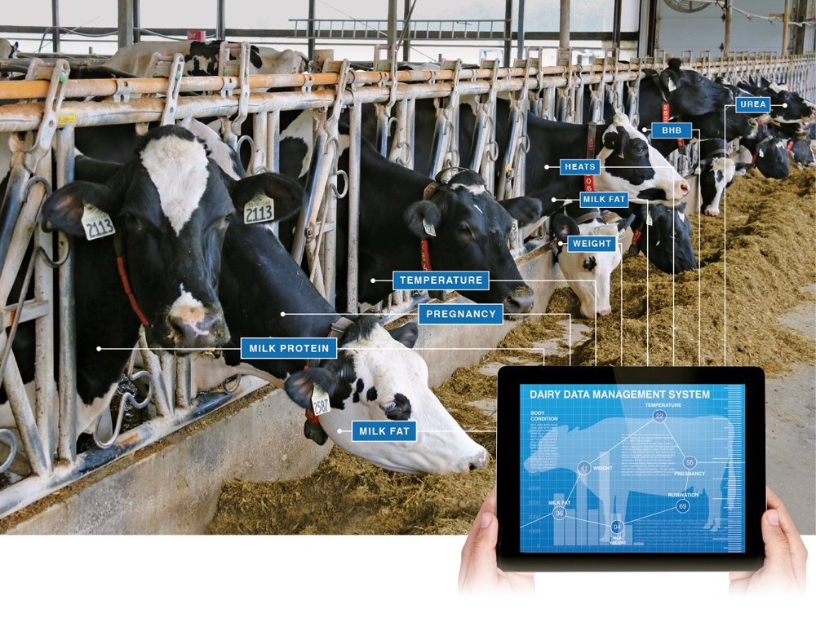
The Innovative Techniques in Animal Husbandry
Dr. Muneeb M. Musthafa
Excerpts from the book chapter titled as The Innovative Techniques in Animal Husbandry by Göncü & Güngör (2018)

Slide 2
Introduction
Increased population- demanding reliable quality livestock products
No. of farms is decreasing, no. of animals per farm and animal production are increasing; livestock production problems increasing
Solution of these problems-technology
In large enterprises- without technology- not possible for high performances

Slide 3
Data monitoring in modern farms- control of production, animal health, and welfare
When no. of animals increases, error burden and work load increase
Successful livestock farmers: adapt their infrastructures to exploit changes in technology for better production
Currently, data is extracted manually: manual observation- replaced by many milking systems by automated recording leading to better data, both in quantity and quality

Slide 4
The automation of animal husbandry and integration of on-farm systems and processes- facilitating the important challenges for competitive market
Technologies provide to dairyman- opportunities to make easier and more convenient decisions on future plans

Slide 5
Technology
Electronic recording
Milking
Reproduction
Auto-weighing
Genetic improvement
Barn optimization

Slide 6
Current Technology Applications
The benefits of new technology:
increased cost efficiency
improved animal welfare
improved working conditions
better production monitoring
improved provision of important production data

Slide 7
The new technology- work easier and improve cattle welfare, production efficiency and profitability
Technologic developments- efficient, profitable and fast solutions for farmers to get on time process using management and direct manipulation possibilities
The latest computer programs- identify and classify sounds of animal for specific situations- to monitor the welfare of animals and provide early identification of disease, physiologic status, and abnormality

Slide 8
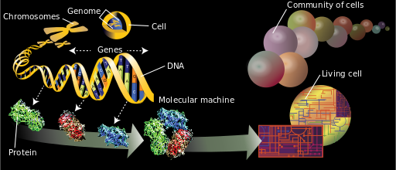
Advances in genetics (proteomics and genomics), new biomarkers- allow the disease to be detected at earlier stages

Slide 9
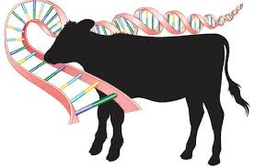
Breeding and genetics
Dairy farms- genetic value of breeding animals cannot get the expected performance without the use of technology
Breeds in animal husbandry has changed a lot with the use of breeding and gene technology
Till 1980s livestock products demands have been met by breed substitution, cross-breeding, and within-breed selection
The demand in future is to be met using new techniques such as such as artificial insemination and more specific selection techniques

Slide 10
Genomic selection provides more possibilities for the more high rate of genetic gain in the livestock sector
After all genomic breeding values- calculated from the genetic marker, rather than from pedigree and phenotypic information in near future
The whole genome mapping for poultry and cattle is completed; new opportunities for animal breeding and animal models

Slide 11
A separate progeny-test category may be developed for farms that collect all data electronically and have those data monitored closely
Automated data collection with parentage verification offers substantial opportunities for genetic improvement of overall economic merit
Nowadays biological samples are sent laboratory for genetic analysis to identify the relevant genes responsible for productive parameters

Slide 12
Computer and internet usage
New technology in computers, biotechnology and scientific discoveries regarding ruminant nutrition and genetics provide the basis for accelerated progress in milk production for dairy farmers
The use of computers for farm management in dairy sector started in as early in 1990s in many developing countries
Computers- larger farms using it
Small-scale farmers- cost and their lack of knowledge about computer use in farming

Slide 13
Breeder can evaluate the monthly lots of data using formulas with high accuracy using software
It can also be programmed for annual report for detail evaluation of herd evaluation
Daily milk yields feed consumption, pregnancy check, inseminated cow list can be programmed for daily work routine
Developed countries heavily use computer and internet- main way to reach information

Slide 14
Undeveloped or developing countries- several reasons limit using computer and internet:
high financial cost
difficulties to use technology
loss of knowledge to economic benefits
hesitate to use new technologies
lack of education
strict personality
poor infrastructure
lack of personal experience and not enough time to spent

Slide 15
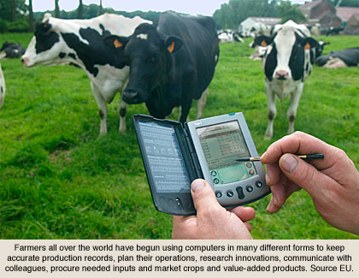
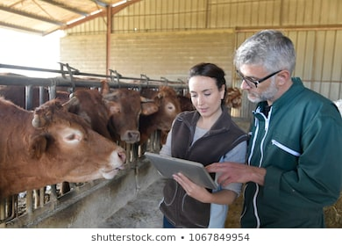
If the farmer evaluates the benefits of using computer and internet they will replace this technology in farm management

Slide 16
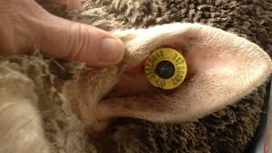
Electronic identification
The Electronic identification system is started 1970s
There are numerous animal ID technologies available to livestock producers:
Radio frequency identification - used to identify cattle
Electronic ear tags
Injectable transponders and boluses with a transponder
These devices have an electronic number that will be unique for an individual animal and link that animal to the database

Slide 17
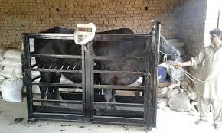
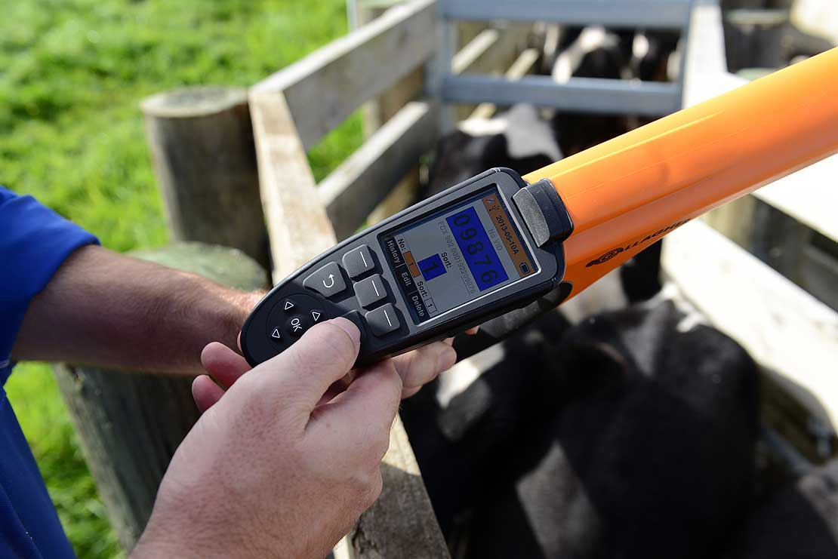
Another technology which is very useful for farmers is electronic weighing system
An easy and powerful electronic weighing system that accurately measures cattle weight
So farmers can monitor cattle performance easily and continuously
Electronic Weighing System
Ear Tag Reader

Slide 18
Milking automation
Milking automation system evolved since 1990s
An automatic milking system requires a completely different management system:
Milking and feeding
cow traffic
cow behavior and grazing
safeguarding milk quality and animal health

Slide 19
The milking robots equipped with sensors:
to detect signs of mastitis which measures the many characters of the abnormal milk pH, somatic cell count, milk acidity, milk conductivity etc
Simple automatic cup removal devices monitor the milk flow rate from individual cows
Post-milking teat disinfection is an established component of many mastitis control strategies

Slide 20
Behavior meter:
installed to the milking systems for animal monitoring
The behavior meter continuously records the lying time, lying bouts and the activity of the individual animals
The cow-behavior observations enable animal welfare assessment in different environmental conditions and stressful situations, as well as reproductive and health status

Slide 21
Electronic separation gates:
The cattle separation is a risky and challenging activity that needs to be done frequently
If milkers also make an animal separation, the milking efficiency and parlor performances decrease
The grouping and separation of cattle in the big herd constitutes an enormous workload for the farmers
Options to separation gate usage at automatic management systems

Slide 22
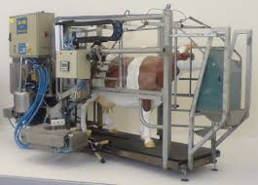
Automatic milking systems using newly developed sensors (NIR, SCC and LDH etc.) provide faster and more effective results
Light spectra- detecting milk abnormalities and measuring various components of milk
Automatic milking systems give many information about milk production, milking speed, milk acidity, milk conductivity etc.
Automatic Milking

Slide 23
Feeding automation
Computer programmes- many software for ration formulation
Optimal feeding programs can be done for advanced options such as live weight, racing, lactation period and animal feed stock information
Automated feeding systems- in many big dairy farms for higher production
System covers- each stage of feeding, feed preparation, mixing equipment and the installations for distributing feed

Slide 24
Feed components such as grass and maize/corn silage as well as mineral feed and feed concentrate will be loaded, mixed and delivered to the feed table built up there by the systems
Computer-controlled calf feeders have many advantages over traditional calf feeding methods
Calves learn to use the computer-controlled milk feeding system fairly easily and this the technology offers a significant reduction in labor cost (73%)
These systems can be combined with automatic weighing and health observation system for calf welfare

Slide 25
Electronic Concentrate Feeding system- each cow is supplied with the exact ration of feed at the exact right time
Electronic sensors- used for rumen pH and rumen temperature of cattle
Sensor used for collecting data for cow jaw movement to estimate chewing activity. This sensor works on the principle that the changing pressure of the animal is not detected during opening and closing of the mouth

Slide 26
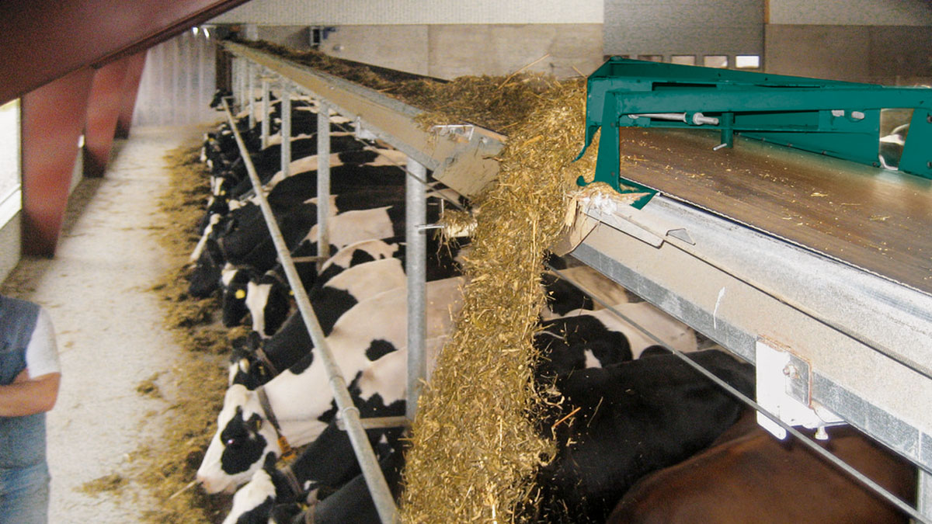
Automatic Belt Feeder

Slide 27
Health observation
An animal disease has serious economic implications on farm productivity
The right time detects disease three to 5 days’ sooner, reduce treatment costs, reduce mortality rates, improve production efficiency
The production, product quality, product composition, body condition, and behavior provide a good indication for the health status of animals

Slide 28
To monitor the health conditions of each cow the sensors are mounted on the cow. Sensor networks consist of several tiny, low price devices and are logically self-organizing ad hoc systems
The role of the sensor network is monitoring the health parameters of animals, gather and convey the information to other sink nodes
Sensors that collect data such as temperature, pH, etc.

Slide 29
Reproductive performances
Traditionally, estrus detection is performed by visual observation of the dairy herd
As a result of technical progress in monitoring cows using computers, automatic estrus detection has become possible
The electronic systems are an electronic device that detects cows that stand to be mounted by a herd mate and provides a continuous monitoring of activity

Slide 30
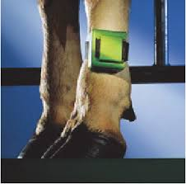
Radio telemetry is a computerized estrus detection devices
During this time, date, time and duration of the mount stored and send to the main computer. On computer all these data evaluated and prepared for final decision
Pedometers are used to detect the estrus by storing past physical activity the current physical activity and comparing it previous activity data
After analyzing data programs prepare report for cow which is activity accepted as estrus

Slide 31
Pedometers also used for estrus detection attached to the leg of the cow to measure the amount of her activity over a unit time span
Many pedometric systems are commercially available
Standing activity systems is commercially available in the markets
Radio signal picked up by receiver and relayed to a buffer and a personal computer to analyze data. This system records cows number, standing time, date and duration to evaluation on time.

Slide 32
Pregnancy check: Pregnancy diagnosis is one of the most important factors to get ideal calving interval.
The most common methods are rectal and trans rectal ultrasonography of the reproductive tract.
An experienced practitioner using ultrasound can reliably diagnose pregnancy from 30 days gestation
Experienced veterinary is able to diagnose pregnancy from 35 days
Pregnancy markers: Enzyme-linked immune sorbent assay (ELISA), radioimmunoassay (RIA) or latex agglutination (LA) tests using blood or milk

Slide 33
Barn environment control
Animal production depends- environment
There are many sensors for use at dairy barn environment control automation:
Eg: Temperature and relative humidity sensors, airspeed sensors, carbon dioxide sensors, ammonia sensors and light sensors etc.
Ambient temperature gets warmer than 25°C cow begins use their energies to cool themselves down rather than to produce milk

Slide 34
Heat stress on dairy cattle physiology and productivity – decrease milk yield by 10%
Environmental factors: air quality are poor, milk production and quality affected adversely
Barn environment is also important for the farm workers
Modern technology- control barn environment: sensor installations to measure - temperature, humidity, solar radiation and luminosity

Slide 35
These sensor and automation systems- capable of recording and adapting to environmental conditions in barn
Automation systems not only can automate for temperature, but also have wind and rain sensors
The wind sensors feed wind speed data into the controller, which then adjusts curtain height to compensate for higher air transfer rates
Rain sensor- programmed to close the curtain to a predetermined height when it rains to keep moisture off cows and stalls

Slide 36
Lighting is the most obvious change with the shift to automatize barn
Digitally controlled LEDs can extend the day, supplementing sun in autumn and winter
New technology: self-regulating, micro-climate controlled environment for optimal animal growth and production
New technologic tools: monitor nearly every aspect of animal barn indoor environment

Slide 37
Thank you

