Slide 1
Advance Organic Chemistry 11 CHS 41022
Advanced Organic Synthesis

Slide 2
Text books
Designing Organic Syntheses: A Programmed Introduction to the Synthon Approach. Stuart Warren Wiley, 1978.
The Logic of Chemical Synthesis E.J. Corey Wiley, 1989.
Modern Organic Synthesis: An Introduction
George S. Zweifel, Michael H. Nantz Freeman 2006.

Slide 3
Retrosynthetic analysis
is a technique for solving problems in the planning of organic syntheses. This is achieved by transforming a target molecule into simpler precursor structures without assumptions regarding starting materials. Each precursor material is examined using the same method. This procedure is repeated until simple or commercially available structures are reached

Slide 4
Approaching the design of a synthesis (Part One)
For simple molecules it can be obvious just by looking at the target structure, for example:
Cyclohexyl bromide
Bromoalkanes are available from alkenes or from alcohols

Slide 5
Methyl benzoate
Esters are available from carboxylic acids by reaction with alcohols;
benzoic acid is available from toluene
Lect., 1/ 5-10-2010

Slide 6
cis-3-octene
cis-Alkenes can be selectively prepared by partial reduction of alkynes; alkynes are accessible via acetylide chemistry.
Lect., 1/ 5-10-2010

Slide 7
DEFINITIONS
what you need to make | TARGET MOLECULE (TM)
the process of deconstructing the TM by breaking it into simpler molecules until you get to a recognisable SM | RETROSYNTHETIC ANALYSIS
an available chemical that you can arrive at by retrosynthetic analysis and thus probably convert into the target molecule | STARTING MATERIAL (SM)
taking apart a bond in the TM to see if it gives a pair of reagents | DISCONNECTION
changing a group in the TM into a different one to see if it gives an accessible intermediate | FUNCTIONAL GROUP INTERCONVERSION (FGI)
conceptual fragments that arise from disconnection | SYNTHON
chemical that reacts as if it was a synthon | SYNTHETIC EQUIVALENT

Slide 8
INTERCONVERSIONS that correspond to known reactions. When you've got to a simple enough starting material (like something you can buy [and usually is cheap]) then the synthetic plan is simply the reverse of the analysis. The design of a synthesis needs to take into account some important factors.
it has to actually work in general,
it should be as short as possible
3. each step should be efficient
4. side products (if formed) and impurities (there always are) should be easily separable from the desired product
5. environmental issues may be relevant
Lect., 1/ 5-10-2010

Slide 9
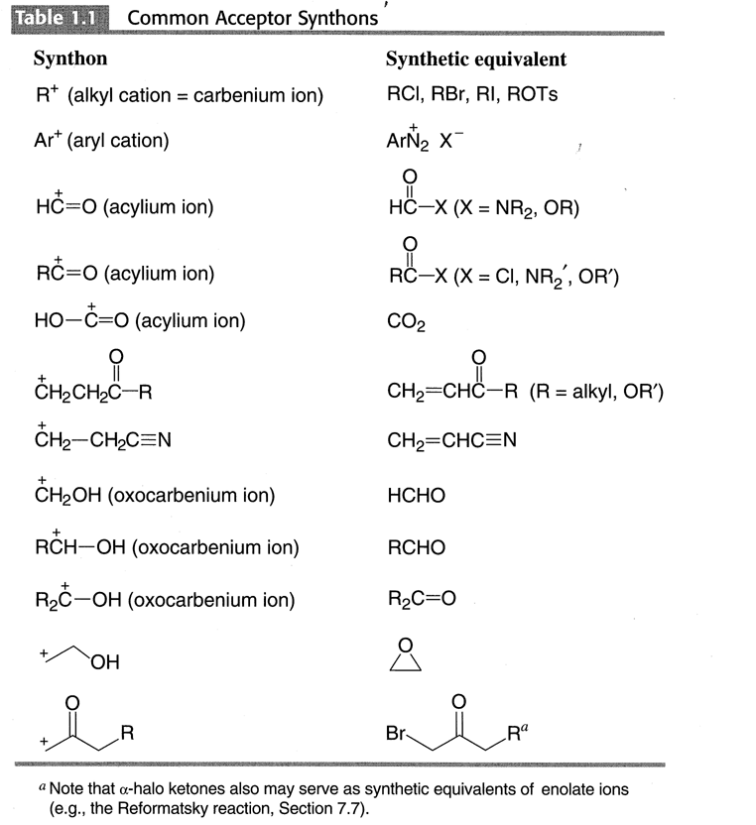

Slide 10
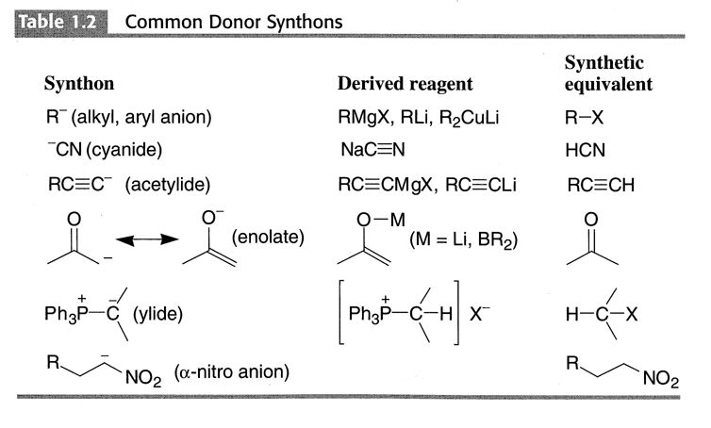

Slide 11
The positive charge (+) is placed at the carbon attached to the E class function group (e.g.,=O,-OH, -Br)
Consonant pattern: Positives charges are placed at carbon
atoms bonded to the electronegative atoms
Dissonant pattern:.
If a consonant pattern is present in a molecule,
a simple syjthesis often be achieved

Slide 12
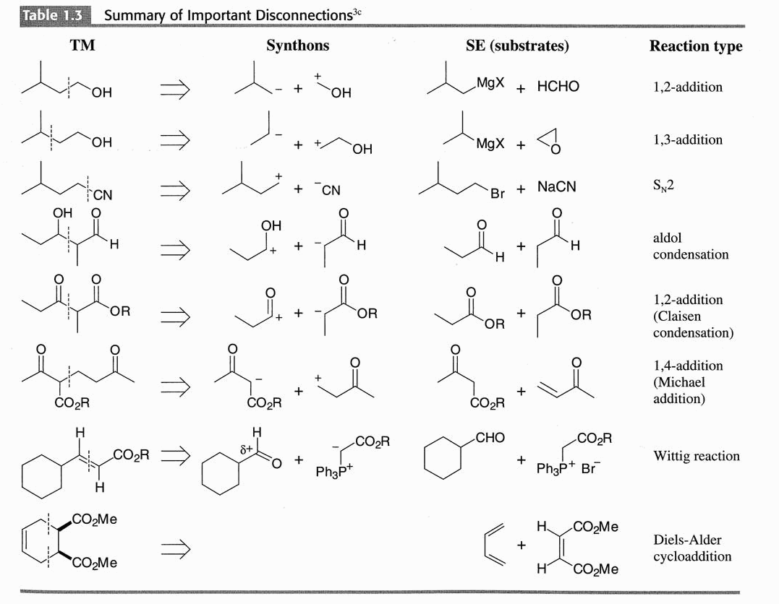

Slide 13
One Functional Group

Slide 14
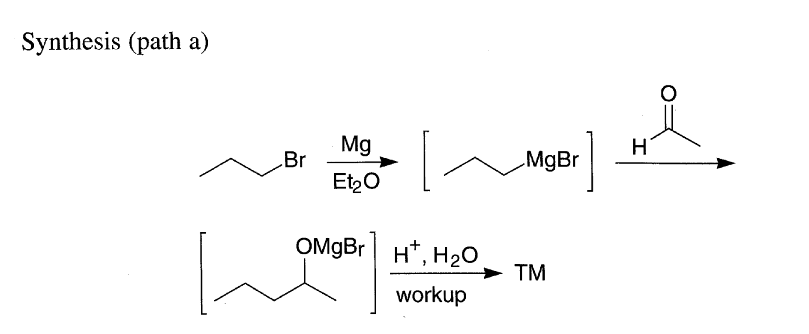

Slide 17
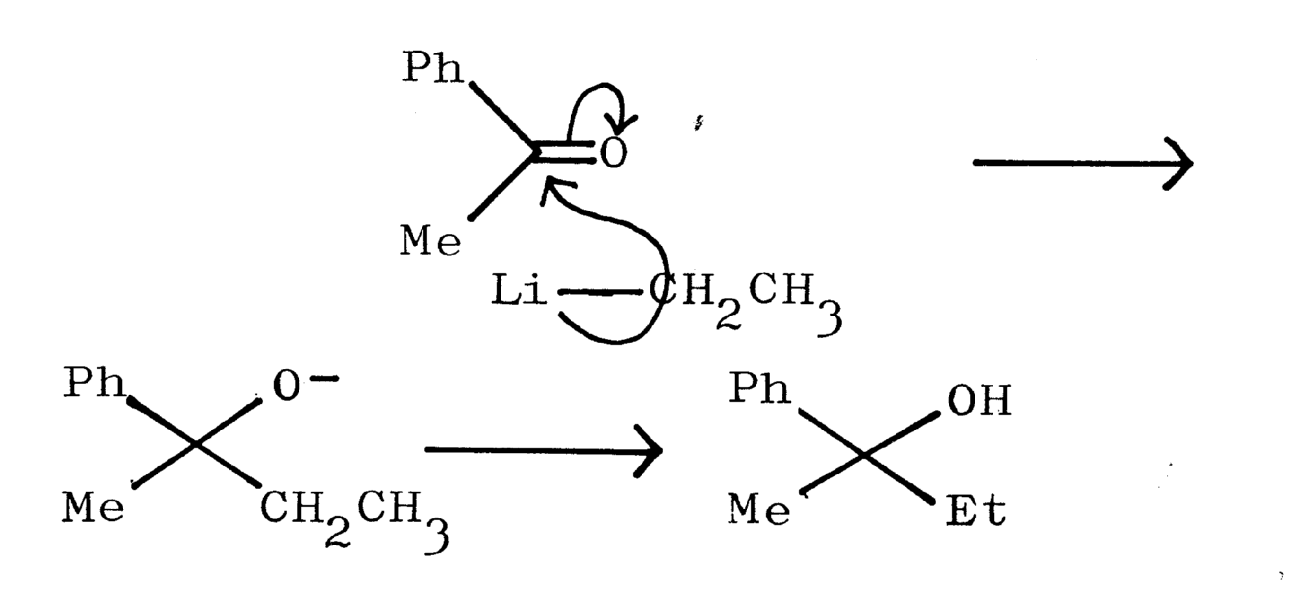

Slide 18
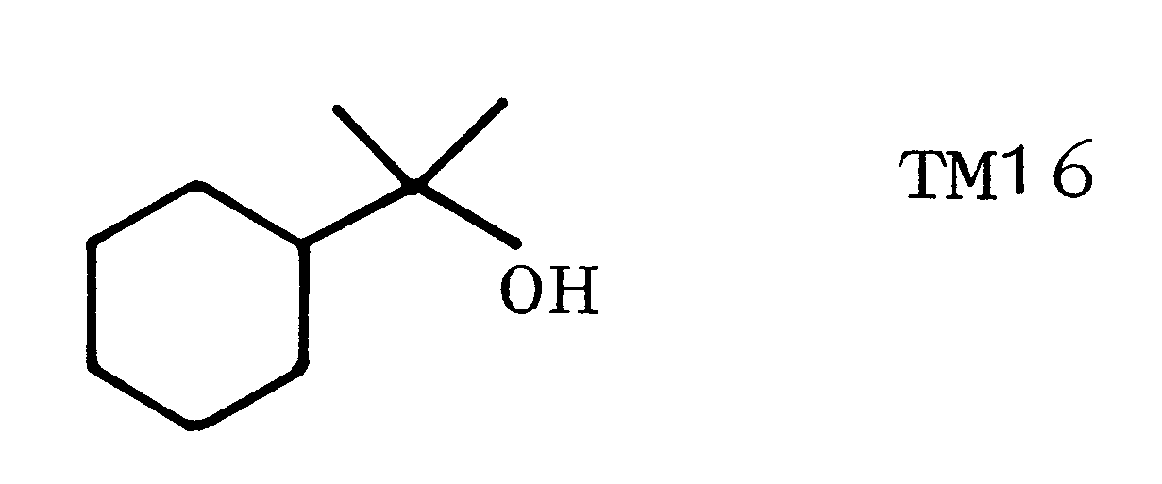
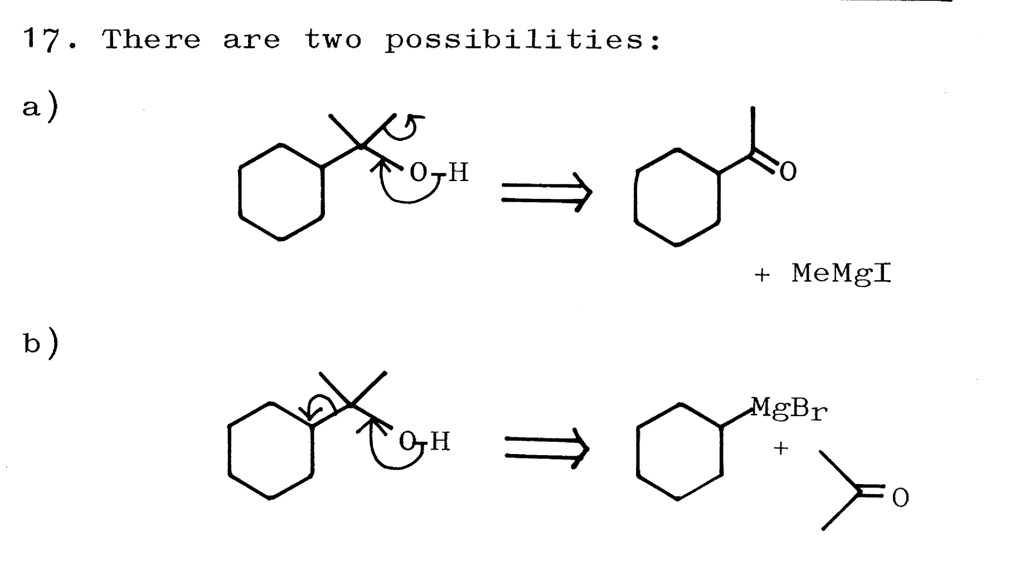

Slide 20
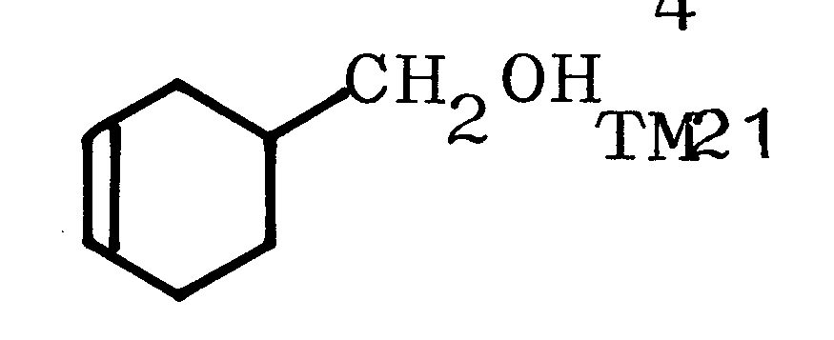

Slide 21
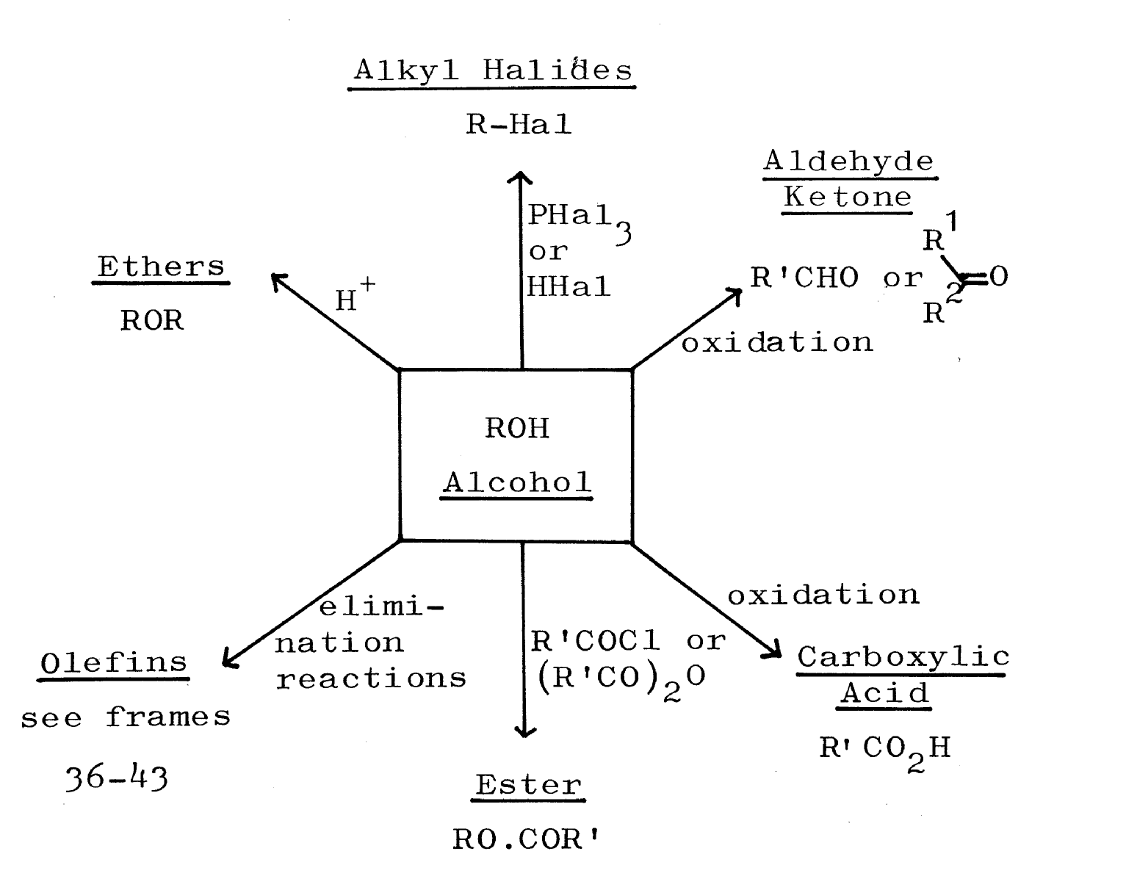

Slide 22
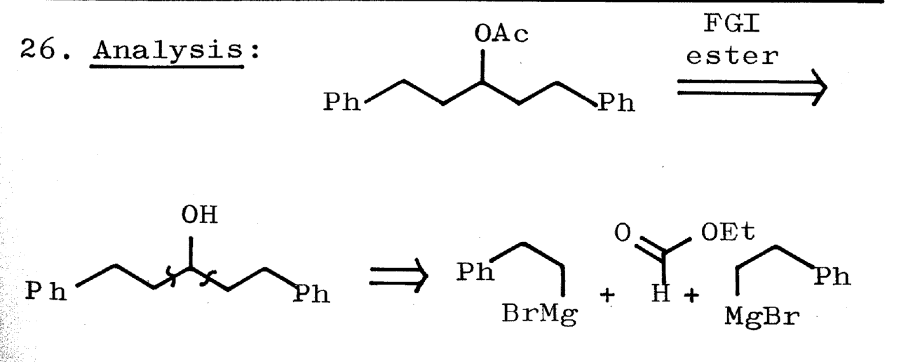
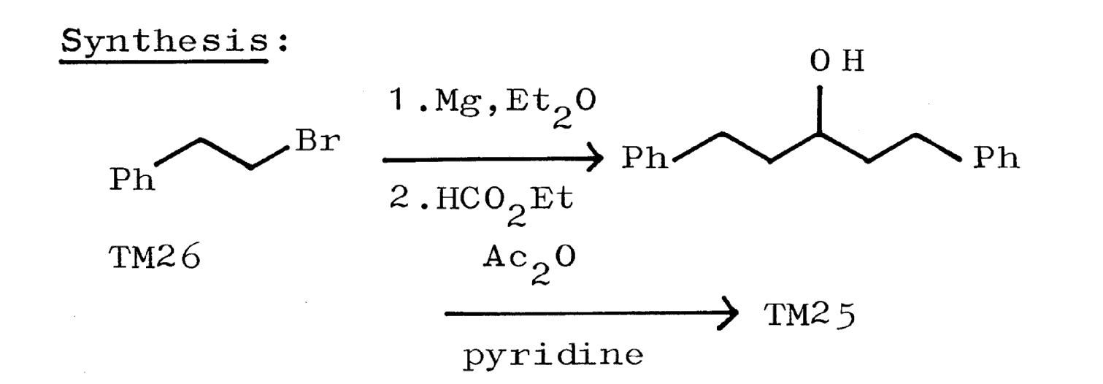

Slide 25
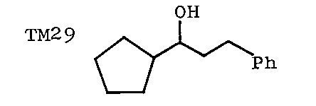
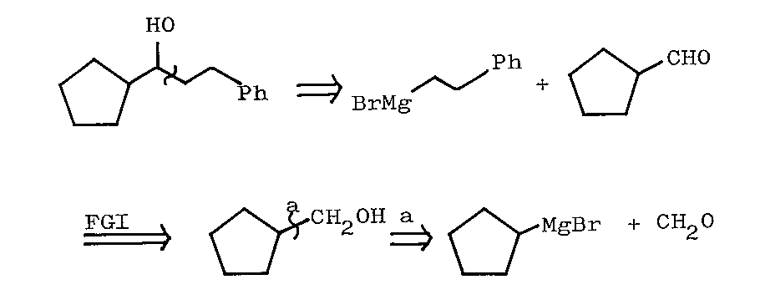
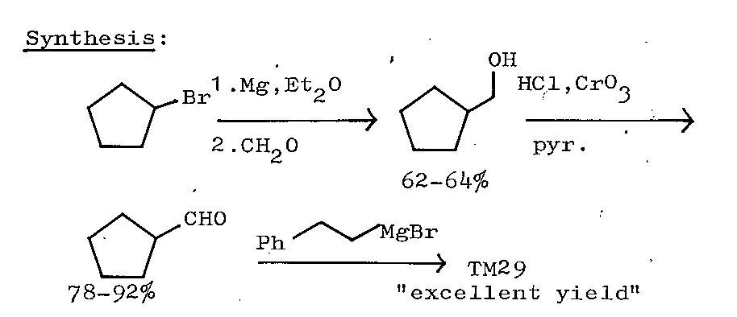

Slide 26
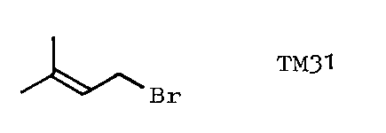
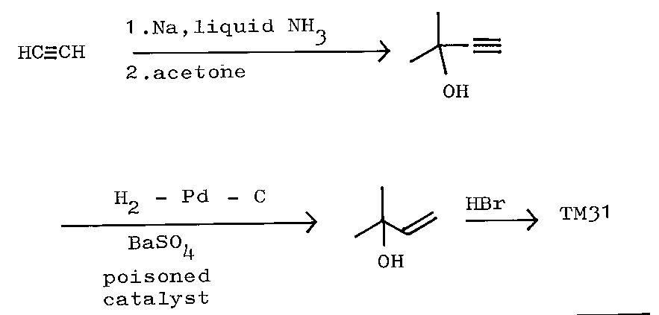

Slide 27
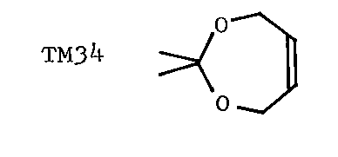
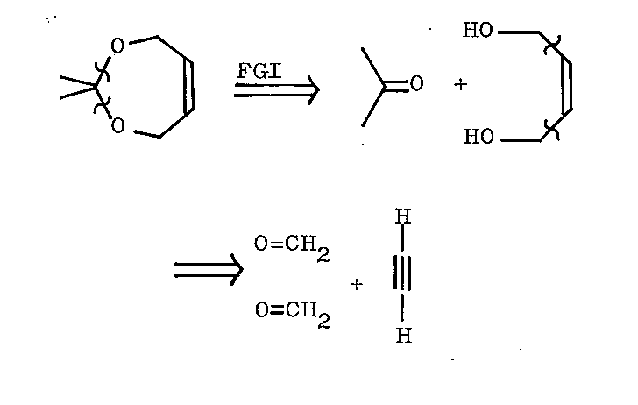
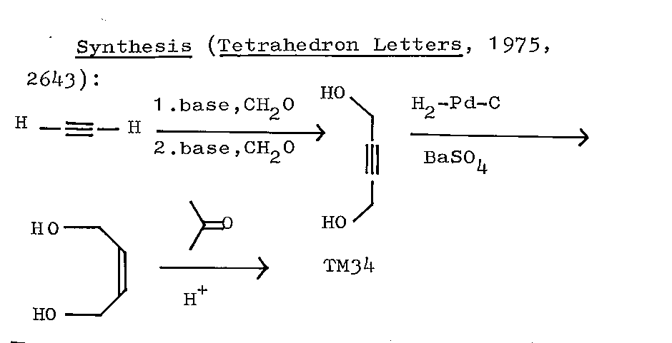

Slide 28
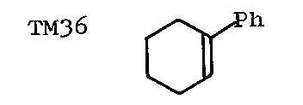
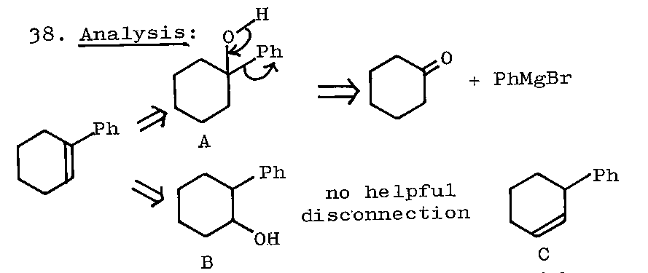

Slide 29
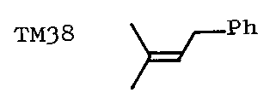
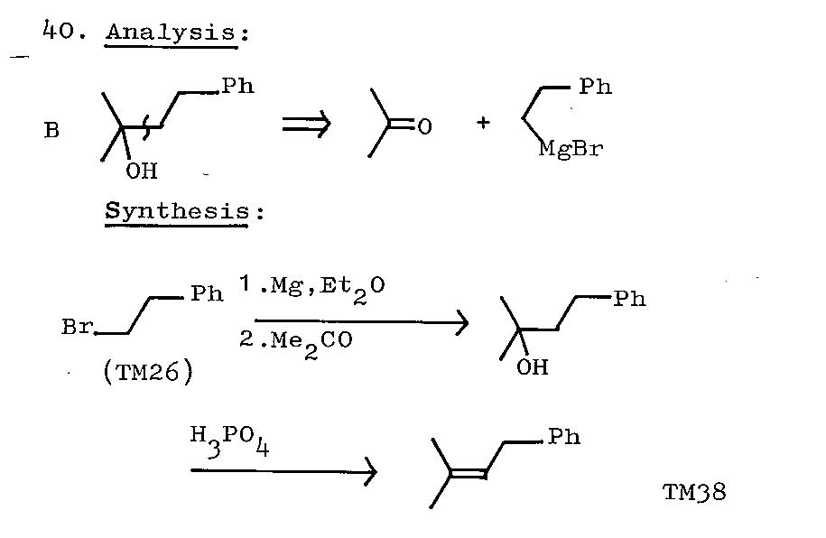

Slide 30
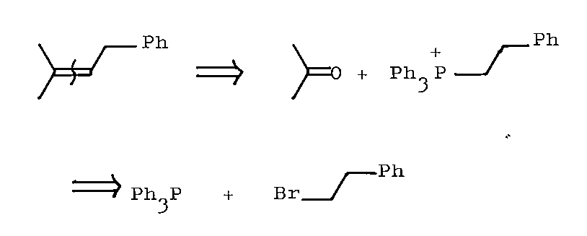
Wittig Reaction

Slide 31
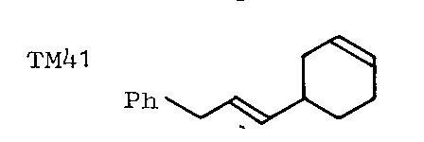
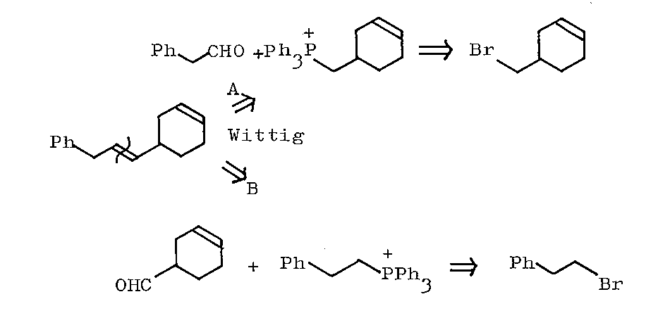
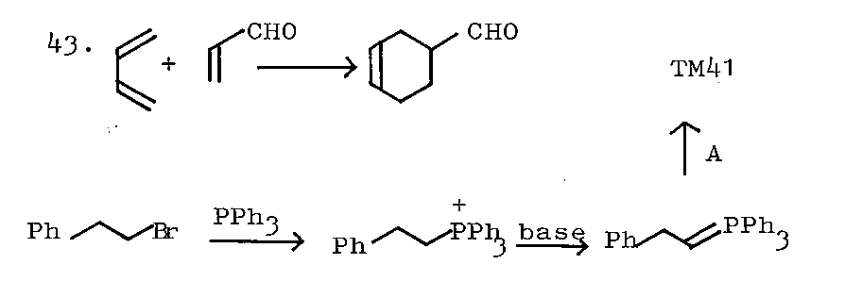

Slide 32
Friedel-Crafts alkylation and acylation reactions
of aromatic substrates

Slide 33
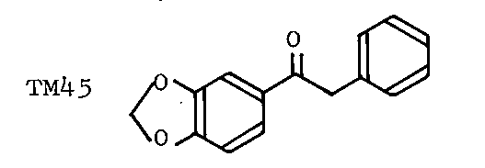
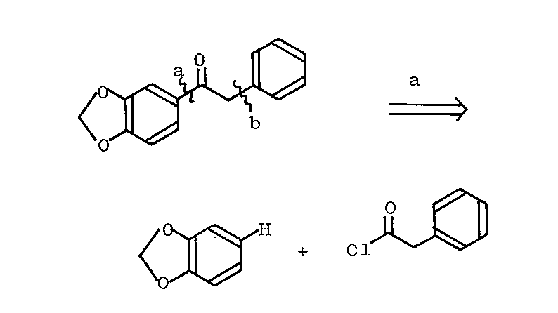

Slide 34
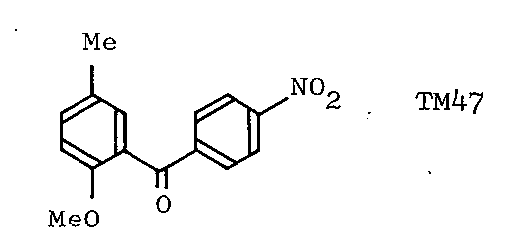
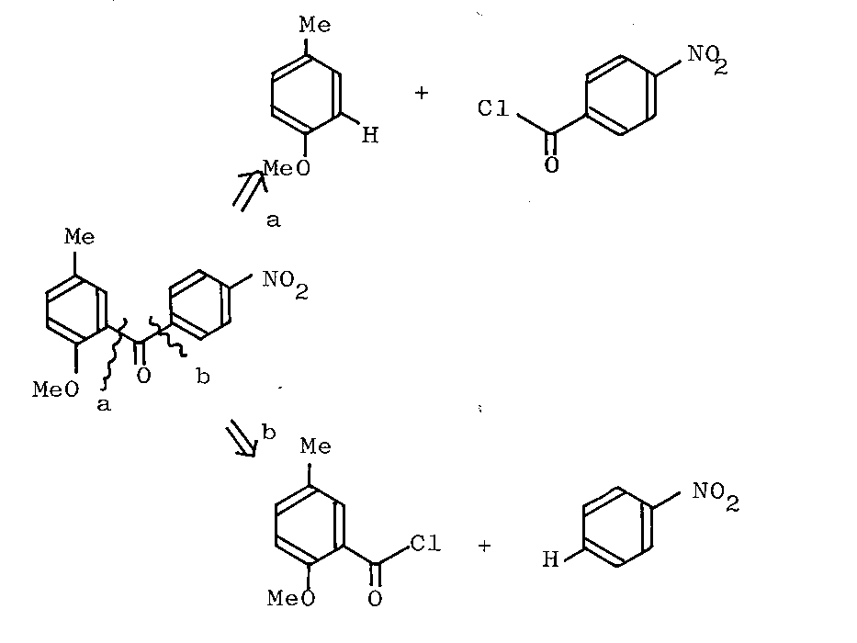
(ortho direction)
(meta direction)

Slide 35
(more active)

Slide 36
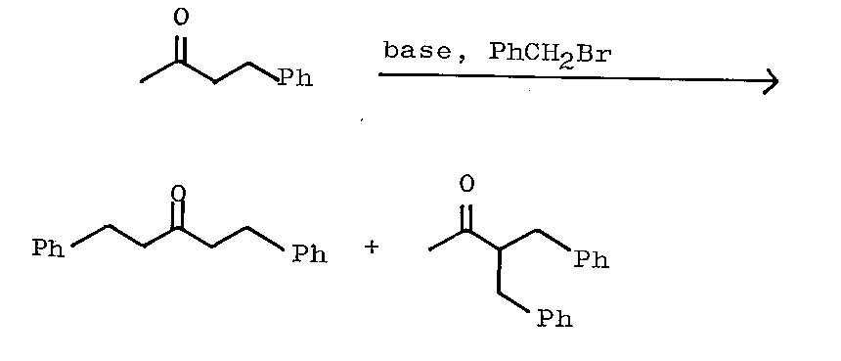
Sometimes, rather than protect one part of a molecule,
it is better to activate another
(poor yield)

Slide 37
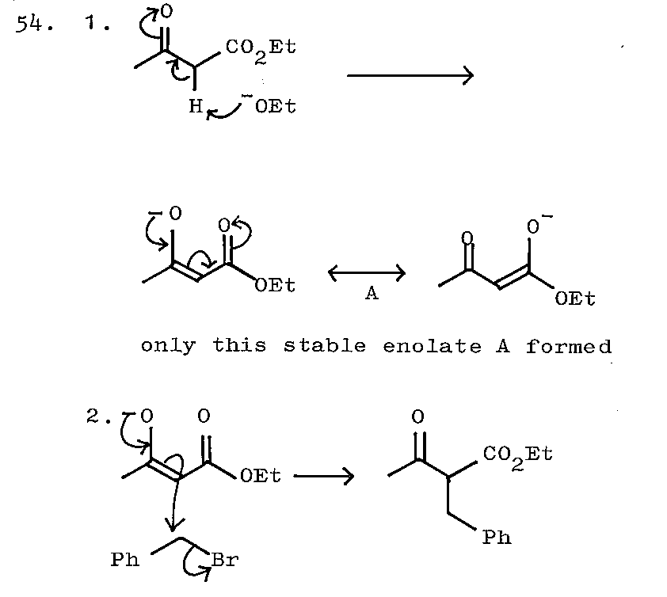
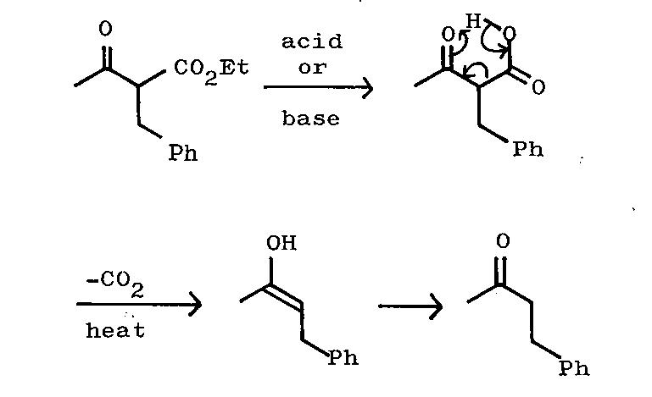
By hydrolysis and decarboxylation

Slide 38
A general synthesis for ketones and the corresponding disconnection

Slide 39
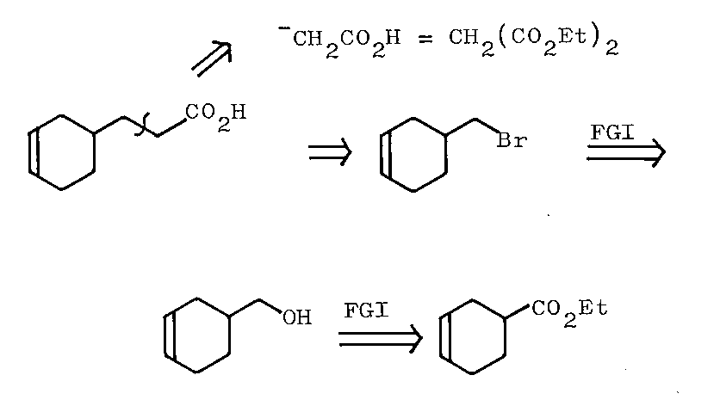
(Diels-Alder reaction)

Slide 40
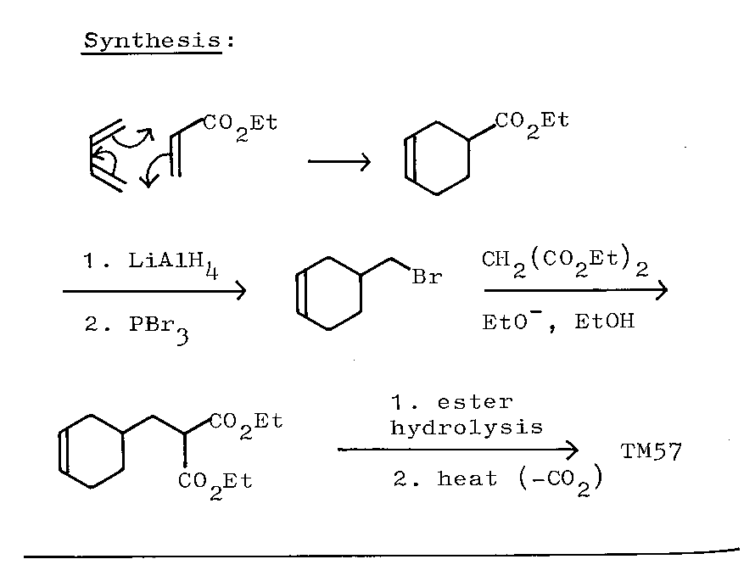
(diene)

Slide 41
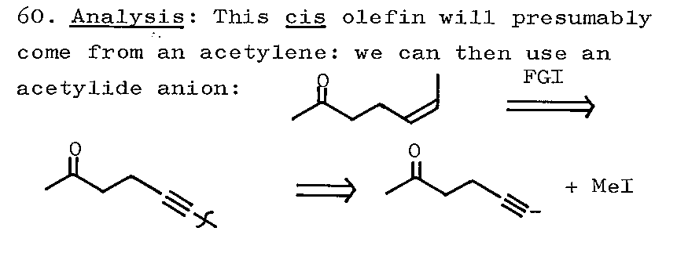
(acetone anion equivalent)

Slide 42
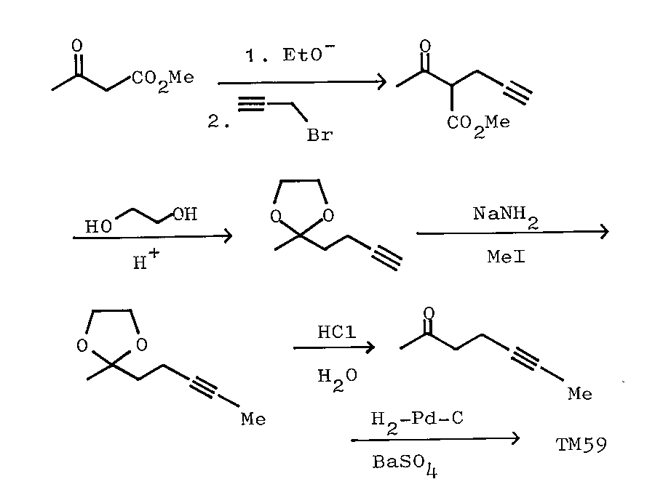

Slide 43
Acid derivatives

Slide 44
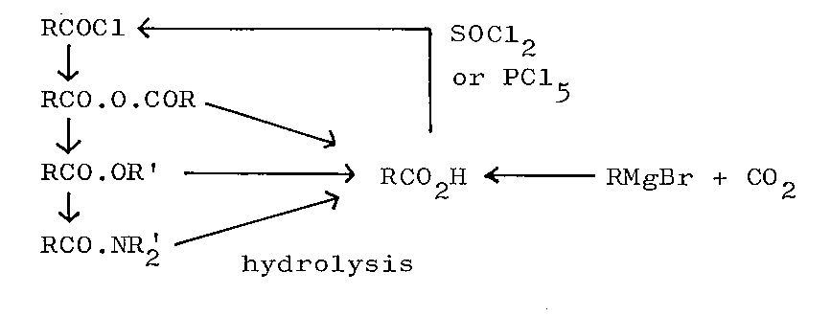

Slide 45
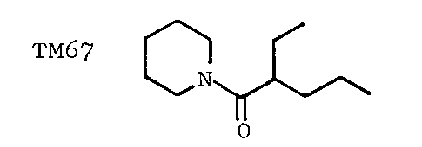
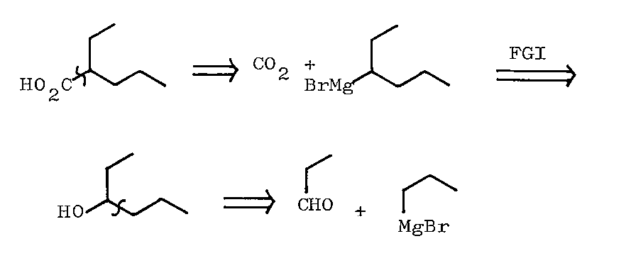
(amide bond formation)

Slide 46
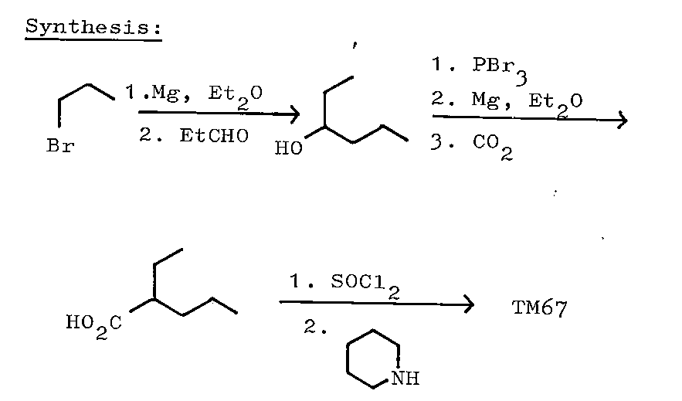

Slide 47
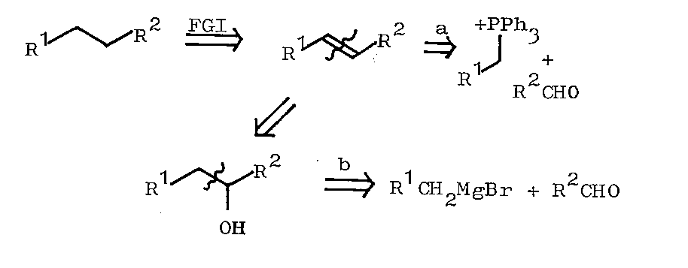
Fully saturated hydrocarbons

Slide 48
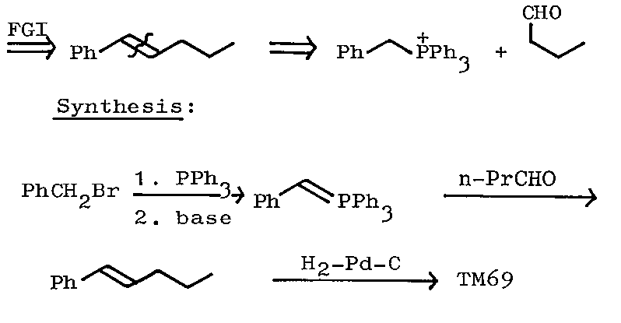

Slide 49
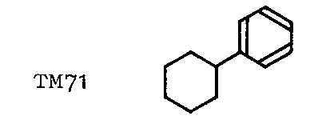
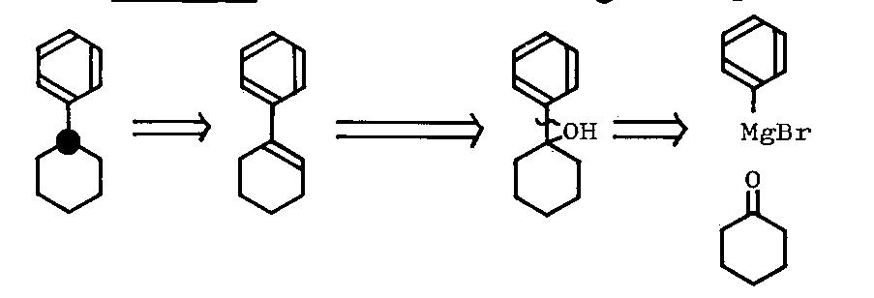

Slide 50
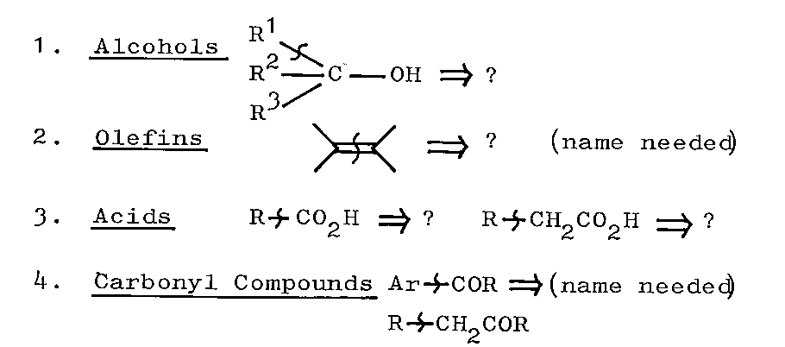
Summary and Revision

Slide 51
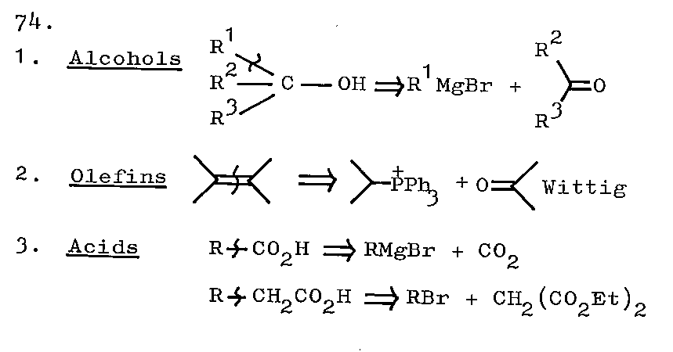

Slide 52
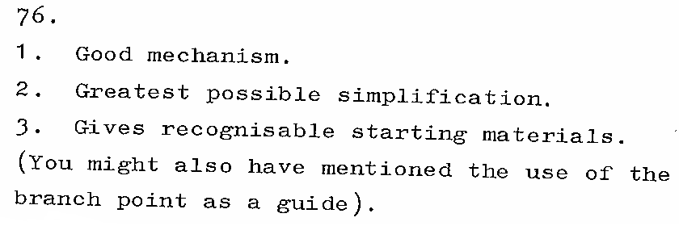
Three or four ways to recognise a good disconnection

Slide 53
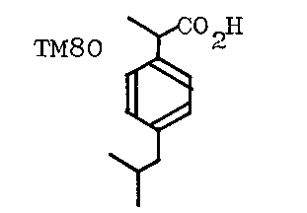
Review Problems
Brufen: Boots anti-rheumatic compound)

Slide 55
Two Functional Groups in a 1,3-Relationship
β-Hydroxy Carbonyl Compounds

Slide 58
α,β-Unsaturated Carbonyl Compounds

Slide 59
Summary

Slide 60
1,3-Dicarbonyl Compounds

Slide 62
Aryl halides need special conditions

Slide 63
Activate needed

Slide 64
Dieckmann Reaction

Slide 65
Review Problem

Slide 66
1,5-Dicarbonyl Compounds (Michael addition)

Slide 75
Illogical Two-Group Disconnection (Dissonant)
The 1,2-Dioxygenation Pattern
a-Hydroxy-Carbonyl Compounds

Slide 78
Strecker Amino Acid Synthesis

Slide 80
Cyanide ion is also involved in one special reaction
giving an α-hydroxy-ketone

Slide 85
1,2-Diol Compounds

Slide 88
Pinacol reduction (radical reaction)

Slide 90
Acyloin reaction

Slide 91
Illogical Electrophiles
α-bromoketone A is electrophilic at
the α carbon atom

Slide 93
The other main illogical electrophiles are epoxieds

Slide 95
Review Problems

Slide 97
(wrong product)
enamine

Slide 104
r-keto acid
Propargyl bromide must provide
a MeCOCH₂⁺ synthon

Slide 105
Review problem

Slide 110
General Review Problem

Slide 121
FGI

