Slide 1
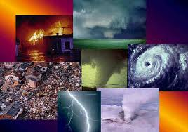
Natural Disasters
Impact on Ecosystem
MH Mohamed Rinos

Slide 2
Definition of Natural Disaster
“A serious disruption of the functioning of society, causing widespread human, material or environmental losses which exceed the capacity of the affected society to cope using only its own resources” (United Nations)
“An event is classified as a disaster if at least 10 people are killed and/or 100 or more are affected and/or an appeal for international assistance is made or a state of emergency declared” (CRED, 2000)

Slide 3
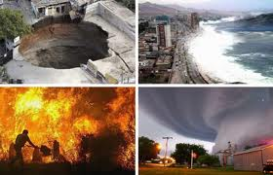
Natural Disasters
Landslide
Drought
Floods
Tsunami
Tropical Cyclones, Typhoons and Hurricanes
Lightning
Fire
Tornados
Volcanoes
Blizzards
Earthquake
Heat

Slide 4
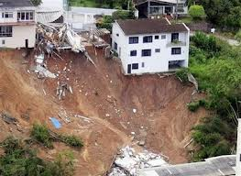
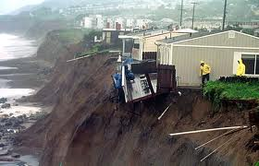
Landslide
A landslide is a geological phenomenon which includes a wide range of ground movement, such as rock falls, deep failure of slopes, and shallow debris flow.
Gravity acting on an over steepened slope is the primary reason for a landslide
An avalanche is caused when a build up of snow is released down a slope, and is one of the major dangers faced in the mountains in winter

Slide 5
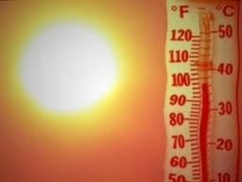
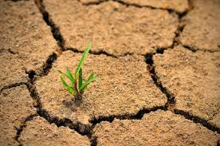
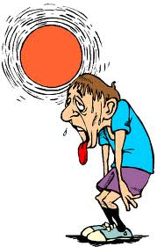
Drought
A long period of abnormally low rainfall, especially one that adversely affects growing or living conditions.

Slide 6
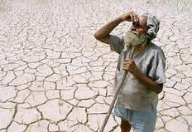
How Drought Impacts the Ecosystem
Young trees die
Dried up lakes and other water sources
Loss of livestock and crops
Losses of fish and wildlife habitat
Lack of food and drinking water for wild animals
Increase in disease in wild animals, because of reduced food and water supplies
Migration of wild animals,
Lower water levels in reservoirs, lakes, and ponds
Loss of wetlands
More fires, reduced soil quality

Slide 7
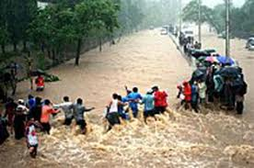
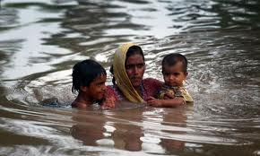
Flood
A temporary rise of the water level, as in a river or lake or along a seacoast, resulting in its spilling over and out of its natural or artificial confines onto land that is normally dry. Floods are usually caused by excessive runoff from precipitation or snowmelt, or by coastal storm surges or other tidal phenomena.

Slide 8
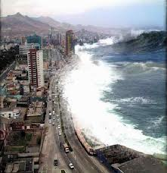
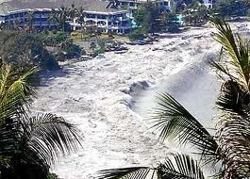
Tsunami
An unusually large sea wave produced by a seaquake or undersea volcanic eruption

Slide 9
How Tsunamis Impact the Ecosystem
Houses, buildings, and other structures destroyed
Loss of power
Erosion
Fresh water contaminated

Slide 10
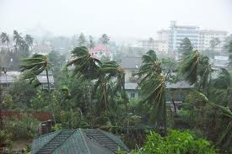
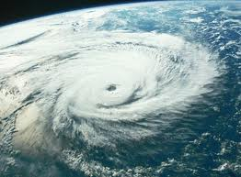
Tropical Cyclones, Typhoons and Hurricanes
These are regional names for the same phenomenon
Tropical Cyclones – Depressions in the tropics which develop into storms in the south-west Indian Ocean, the Bay of Bengal, and the Arabian Sea, parts of the south Pacific and along the northern coasts of Australia
Typhoons - north-west Pacific
Hurricanes - in the Caribbean, south-east United States and Central America.

Slide 11
How Tropical Cyclones, Typhoons and Hurricanes Impact the Ecosystem
Erosion
Houses, buildings, and other structures destroyed
Heavy flooding of inland areas
Tornadoes
Loss of power
Disconnect water supply

Slide 12
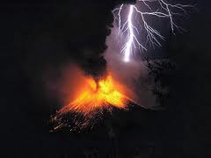
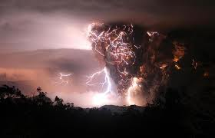
Lightning
A brilliant electric spark discharge in the atmosphere, occurring within a thundercloud, between clouds, or between a cloud and the ground

Slide 13
How Lightning Impacts the Ecosystem
Fire
Loss of power

Slide 14
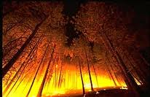
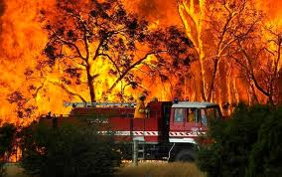
Fire
An uncontrolled fire occurring in vegetation more than 6 feet (1.8 m) in height
These fires often reach the proportions of a major conflagration and are sometimes begun by combustion and heat from surface and ground fires

Slide 15
How Fire Impacts the Ecosystem
Houses, buildings, and other structures destroyed
Loss of habitat

Slide 16
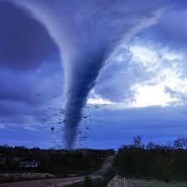
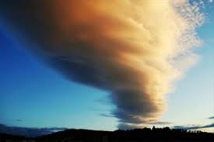
Tornados
A violently rotating column of air extending from a cumulonimbus cloud to the Earth, ranging in width from a few meters to more than a kilometer and whirling at speeds between 40 and 316 mi per hour.

Slide 17
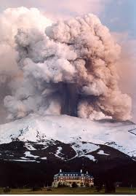
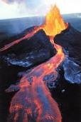
Volcanoes
A vent in the earth's crust through which lava, steam, ashes, etc., are expelled, either continuously or at irregular intervals

Slide 18
How Volcanoes Impact the
Ecosystem
Houses, buildings, and other structures destroyed
Fires
Toxic gases released into the atmosphere
Carbon dioxide emitted from volcanoes adds to the natural greenhouse effect.
Loss of habitat

Slide 19
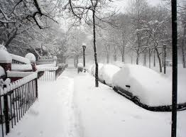
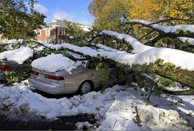
Blizzards
A violent snowstorm with winds blowing at a minimum speed of 35 miles per hour and visibility of less than one-quarter mile for three hours

Slide 20
How Blizzards Impact the
Ecosystem
Flooding when snows melt
Trees fall
Power outages
Hypothermia

Slide 21
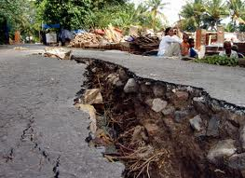
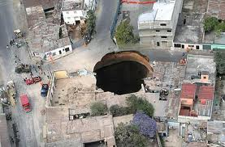
Earthquake
A sudden movement of the earth's crust caused by the release of stress collected along faults or by volcanic activity

Slide 22
How Earthquakes Impact the Ecosystem
Destroy buildings
Property damage
Mud slides
Fires
Floods
Tsunamis
Loss of power

Slide 23
Heat
An air mass of high temperature covering an extended area and moving relatively slowly
A period of abnormally hot and usually humid

Slide 24
How Flooding Impacts the
Ecosystem
Disease
Loss of habitat
Houses, buildings, and other structures destroyed
Household wastes get into the water system
Power outages

Slide 25
How Tornadoes Impacts the
Ecosystem
Tornadoes could hit hazardous or toxic materials which could carried by a thunderstorm and then transported along ways down stream.
Could transport certain types of small animals and plants across the land
Destroys topsoil and crops

Slide 26
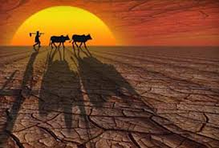
THANK YOU

